Slide 1
Hello and welcome to
Virtual Future Heroes Routes into session we will begin shortly.
Please mute your mics and switch off your cameras.
If you need technical assistance please use the chat box and we will be happy to help.

Slide 2
House Keeping Rules
Please mute your microphone and turn off your cameras. This will help us manage background noise during the presentations.
Please do not take any recordings or screen shots of the screen during the session
If you need any technical help during the event please message us using the chat box.
If you would like to ask a question please use the chat box. We will try to answer as many questions as possible at the end of the session and any we do not get to we will follow-up afterwards.
The session will be not be recorded live but we will be uploading the presentations to the Extra Heroes webpage after this session.
Please bear with us if there are technical issues we will resolve them as quickly as possible. You may find that some of the videos we play may buffer, we will share the links after the event for anyone who had any issues watching them.
Social media – please tag us in @hwe_academy and #Future Heroes
Most importantly – please join in with the quizzes and activities
Your feedback is important to use please feel free to email us – academy.hwe@nhs.net

Slide 3
Overview of The Prince’s Trust
Routes into Health and Social Care

Slide 4
Overview – The Prince’s Trust
Youth Charity – founded by HRH The Prince of Wales, in 1976
Helps young people, aged 11-30, get into jobs, education or training
Programmes:
Achieve – School-based personal development programme (11-19)
Explore – Personalised skills development programme (16-25)
Team – 12-week personal development programme (16-25)
Get Started – Themed taster sessions, e.g. sports, digital (16-25)
Get into – sector pre-employment training programmes (16-30)
Development Awards – small grants to access training/jobs (18-25)
Enterprise – explore self-employment, start-up finance/mentoring support (18-30)

Slide 5
Health and Social Care Offer
2020-2024, partnership with the Department for Health and Social Care (DHSC) to support 10,000 young people, aged 16-30, into health and social care jobs/apprenticeships
Get Into | Get Started | Mentoring Support
2-6 weeks programme of placement and training Level 1 or 2 H&SC and employability qualifications 12-15 young people, 50% into employment | 3-day intensive programme of placement, employability skills training and multiple organisation interview 30 young people interviewed for at least 20 entry-level vacancies | 1 to 1 support for delegates for up to 6 months after completion of the programme predicted 50% of young people will access this

Slide 6
Routes into Health and Social Care
Onboarding
Underpinning Principles
Entry route to Employment
Example Career Pathway
Direct
employment
Healthcare Assistant – Level 2* or Level 3*
Healthcare Support Worker Apprenticeship Qualification (12-18 months)
Care Assistant
Facilities Management
Prince’s Trust H&SC programmes
Values and Behaviours, Functional Skills, Care Certificate
Apprenticeship
HCA Pool
Bank

Slide 7
How to apply
0800 842 842
The Prince's Trust | Start Something (princes-trust.org.uk)
Prince's Trust East of England - Home | Facebook
Prince's Trust Central England (@TrustEngland) / Twitter
Prince’s Trust – YouTube
@princestrust

Slide 9
Studying and applying for Healthcare courses at university
University of Hertfordshire – Sarah Bouvier

Slide 10
Healthcare courses at Herts
Midwife
Nurse
Pharmacist
Clinical psychologist
Physician associates
Dentist
Doctor
Midwife
Nurse (Adult/Child/Mental Health/Learning Disabilities)
Pharmacist
Optician
Social Worker
Art therapist
Therapeutic radiographer
Diagnostic radiographer
Paramedic
Physiotherapist
Dietitian

Slide 11
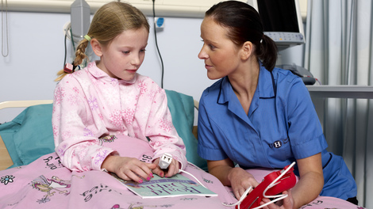
Studying at university
50% of your time in university
50% of your time in practice placements

Slide 12
Applying to university
To be accepted on a degree course you will need:
GCSEs
At least 5 GCSE’s 9 to 4, and need to include English language, and maths (or equivalent core skills). Some programmes require 9-4 in at least one science subject
Your level 3 qualifications
Combinations from:
BTEC
A levels
Some courses will ask for specific subjects.
Application Process
Complete an application (UCAS)
Personal Statement (approximately 500 words)
Why you want to study the course
Why you think you’ll do well on the course
Interview

Slide 13
Applying for health based programmes
Step 1
Step 2
Step 3
Research
(professional body)
Core values & qualities required
Current issues

Slide 14
NHS values apply to all health careers
Working together for patients
Compassion
Improving lives
Everyone counts
Respect and dignity
Commitment to quality of care

Slide 15
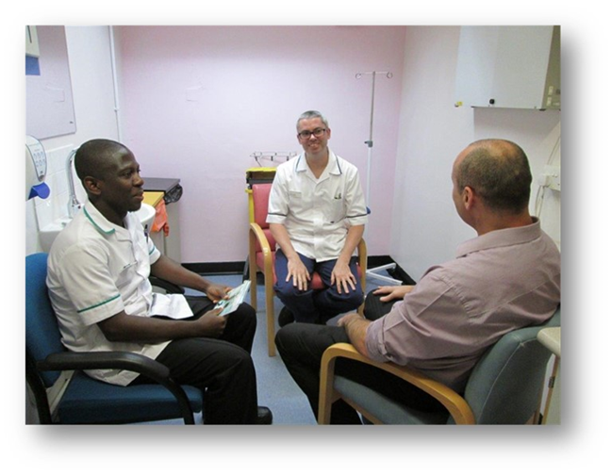
Key personal qualities for health careers
Excellent communicator
Genuinely interested in people
Ability to treat all people equally
Ability to blend patient care with practical and technical skills
Teamworker (but also able to use initiative)
Physically fit
Critical thinkers

Slide 16
Applying for health based programmes
Step 1
Step 2
Step 3
Research
Core values & qualities required
Current issues
Experience
Try to get some experience related to your chosen profession

Slide 17
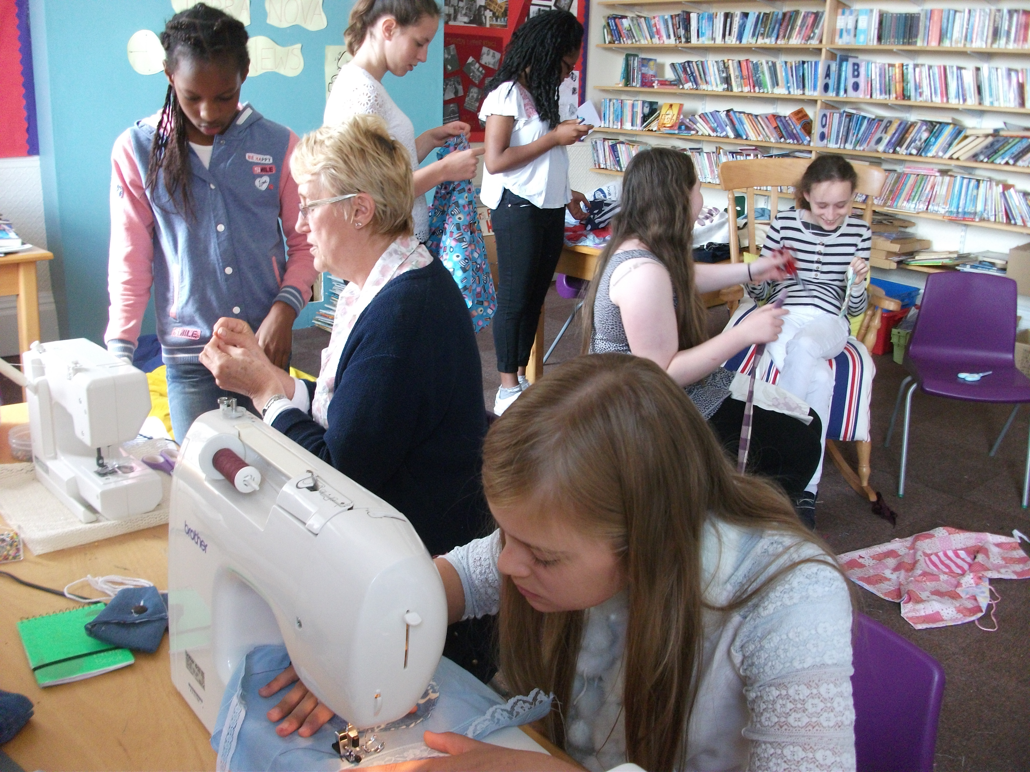
Relevant work/voluntary experience
www.herts.ac.uk/about-us/school-and-college-liaison/getting-ready-for-university/gaining-experience-during-a-lockdown

Slide 18
Applying for health based programmes
Step 1
Step 2
Step 3
Research
Core values & qualities required
Current issues
Experience
Try to get some experience related to your chosen profession
Demonstrate
Refer to core values and qualities required throughout your personal statement. Give examples.

Slide 19
common to all health programmes
Evidence of experience relevant to your chosen profession
Transferable skills related to your chosen profession
Knowledge/ insight/ understanding of your chosen profession
Show passion for your chosen profession
Include hobbies & interests but write about the skills you learned from them
What motivated you to consider this profession

Slide 20
Personal Statement
Part | Content
1 | Open with why you want to study your chosen subject.
2 | Demonstrate your interest in the subject. This section is VERY important.
3 | Relate what you are currently studying to your chosen degree.
4 | Show you have the qualities required to cope with the demands of studying at university.
5 | Close with a final thought.
www.herts.ac.uk/about-us/school-and-college-liaison/getting-ready-for-university/personal-statements

